Slide 1
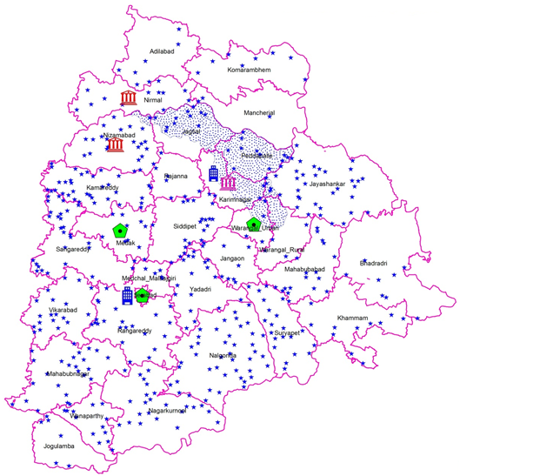
GOVERNMENT OF TELANGANA
GROUND WATER DEPARTMENT
NATIONAL HYDROLOGY PROJECT
1ST WORLD BANK MISSION – 17TH & 18TH AUGUST, 2017

Slide 2
Details of SPMU(Position), Staff strength.
State Project Monitoring Unit at State level in Telangana state is Constituted with the following dedicated Staff to monitor NHP activities of both Surface and Ground Water Departments.
S.No | Designation | Role in SPMU
1 | Special Chief Secretary , I& CAD Department , Government of Telangana, Hyderabad | NHP Project Coordinator
2 | Engineer-in-Chief(I), I&CAD Department, Jalasoudha, Hyderabad | Project Formulation & Monitoring Officer
3 | Chief Engineer, Surface water , (Hydrology & Investigation) , I&CAD Department, Jalasoudha , Hyderabad | NHP Nodal Officer(IA), Surface Water
4 | Director, State Ground water Department , Chinthala Basti, Hyderabad | NHP Nodal Officer(IA), Groundwater
5 | Superintending Engineer, I&CAD Department, Surface water(Hydrology), Jalasoudha, Hyderabad | Unit Officer and Convener of SPMU

Slide 3
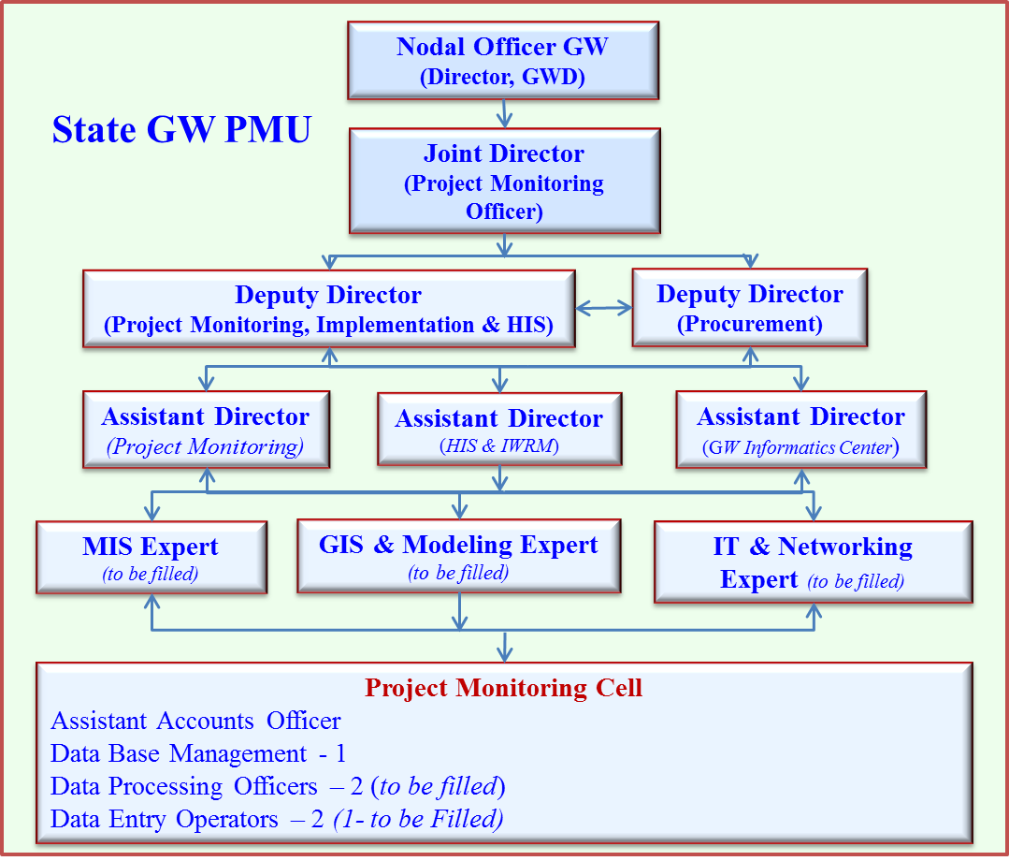
Details of SPMU & Ground Water PMU
Project Coordinator
(Principal Secretary, I&CAD Dept.)
SPMU
Nodal Officer GW
(Director, GWD)
Project Formulation & Monitoring Officer
(ENC - Irrigation)
Nodal Officer SW
(CE, Hydrology & Investigation)
Superintendent Engineer
along with NHP Unit
Field Unit
DGWO
( 31 District units )
Field Officers
(Project Implementation)
DEO
(to be filled)

Slide 4
2 Funds Received (2016-17), (2017-18) and Expenditure till date year wise
Status of Funds recieved and Expenditure during 2016-17 .
Rs. In Lakhs
Sl. No | Year | Opening Balance As on 1-4-2016 | Receipts from GOI during 2016-17 | Interest | Total | Exp. Made upto 31-3 -2017 | Balance as on 1-4-2017
1 | 2016-17 | 0.000 | 195.00 | 0.94 | 195.94 | 0.00 | 195.94
Status of Funds received and Expenditure during 2017-18.
Rs. In Lakhs
Sl. No | Year | Opening Balance As on 1-4-2017 | Receipts from GOI during 2017-18 (First Tranche) | Interest | Total | Exp. (up to July -17 ) | Balance
1 | 2017-18 | 195.94 | 324.00 | 1.97 | 521.91 | 3.806 | 518.10

Slide 5
3. Major Procurement Item in PIP(Item Code, item and amount)
Item Code | Item | Amount (Rs.in Lakhs)
A.Water Resources Data Monitoring System | Construction of PZs with Protection works to improve GW Monitoring Network in the state | 800.00
 | Real Time Data Acquisition System (RTDAS) for Groundwater Monitoring in the state, PDS and DSS area. | 1125.00
 | Protection works for Piezometers drilled under HP-II and Rejuvanation of Existing piezometer for effective water level measurement in Piezometers constructed | 270.00
 | Civil works for Purpose Driven Studies, O&M for piezometers and O&M Contingencies | 122.00
 | Proposed Water Quality lab at Siddipet to distribute the work load for timely analysis (construction + equipment) | 170.00
 | Upgradation of existing Water Quality Labs at Hyderabad & Karimnagar including AMC and consumables | 117.76
 | Establishment of Regional Ground Water Informatics Centre in Karimnagar, Upgradation of State Data Centre at Head Office, Training cum Informatic Centres and Renovation / Construction of District Data, Training cum Informatic Centre (Nizamabad & Nirmal). | 310.5
 | Procurement of geophysical and field equipment (logger, DRS, DAS and field equipments etc.) | 397.5
 | Office maintenance of State and District Data Centres including Hiring of vehicles | 337.5
 | IT equipment for State and District Data Centres including softwares | 549.75
 | Sub Total.A | 4200.01
B. Water Resources Information System (WRIS) | Creation and automation of central data base and integrate with National Water Resource Information System (WRIS) | 140.00
 | TSGWD website development, development of software for village wise Gw estimation and maintenance, mobile application for data communication and upgradation of data entry and analysis software etc. | 120.00
 | Georeferencing of Groundwater Monitoring network | 30.00
 | Procurement of Survey of India (SOI) Toposheets (hard copy & digital data) for studies and development of information brochures | 60.00
 | Sub Total.B | 350.00
Contd….

Slide 6
Item Code | Item | Amount (Rs.in Lakhs)
C. Water Resources Operation and Planning | Expansion of Decision Support System (Planning) for entire SRSP Command area - To develop macro level comprehensive Decision Support System tool for management of command area water. Integrated study with Surface water. | 75.00
 | Seven Purpose Driven Studies are proposed (1) Impact of urbanisation on Gw quality & management of Gw in GHMC, 2) Comprehensive Assessment of Water Resources management in upcoming smart city, Warangal town, 3) Tanks as source for regional Groundwater Recharge, using Managed Aquifer Storage & Recovery (ASR), 4) Study on impact of artificial recharge on groundwater regime, 5) Impact of sand mining on groundwater, 6) Groundwater Model development in micro basin of Hard rock in Krishna and Godavari River Basins of Telangana, 7) Study to delineate basin wise subsurface geometry in 3D using existing data and evaluation of aquifer characteristics in Telangana region to develop comprehensive ground water Atlas | 900.00
 | Resource material for PDS & DSS and policy support | 75.00
 | Sub Total.C | 1050.00
D. Institutions Capacity Enhancement | Trainings – national, international , inhouse trainings and study tours including awareness programmes | 232.9
 | Establishing and Operational Cost of PMU | 125.00
 | Creation of resource material (Annual Reports, pamphlets, Brochure, posters, audio visuals, documentaries etc.,) on water conservation & management awareness creation to water users (Information Education & Communication) | 30.00
 | Hiring of vehicles for investigations and HIS data collection. | 250.00
 | Operation & Maintenance costs including incremental staff costs | 762.00
 | Sub Total.D | 1399.9
Grand Total (A+B+C+D) |  | 6999.9
Project Cost |  | 7000.00
Contd….

Slide 7
4 : Major Procurement item in 2016-17 & their status ( Item Code, item, amount)
S.No | Item Code |  | Item | pproved/ Allocated Amount | Amount utiized | Status
 | A: Water Resources Data Monitoring System
1 | A1 .2.03 | Protection works for Peizometers drilled under HP-II |  | 20.00 | 0.000 | Prepared Bid Document along with specifications and uploaded in MIS and STEP and submitted to NPMU , MoWR for review and approval
2 | A1 .6.02 | Updation of existing Water Quality Labs at Hyderabad & Karimnagar |  | 80.00 | 0.000 | Prepared Bid Document along with specifications and uploaded in MIS& STEP and submitted to NPMU , MoWR for review and approval
3 | A1.7.01 | Borehole Logging Equipment with AMC support |  | 50.00 | 0.000 | Prepared Bid Document along with specifications and uploaded in MIS & STEP and submitted to NPMU , MoWR for review.
4 | A1.7.02 | Rejuvanation of Existing Pz for effective water level measurement in Pzs constructed |  | 10.00 | 0.000 | Preparation of Bid Document is under process

Slide 8
5 : Major Procurement item in 2017-18 & their status ( Item Code, item, amount)
S.No | Item Code |  | Item | Approved Amount | Amount utiized | Status
 | A Water Resources Data Monitoring System
1 | A1 .2.03 | Protection works for Peizometers drilled under HP-II |  | 100.00 | 0.00 | Draft Bid Document is prepared .submission under process
2 | A1.7.02 | Rejuvenation of Existing Pz for effective water level measurement in Pzs constructed |  | 40.00 | 0.00 | Preparation of Bid Document is under process for total approved quantity of 2016-17 and 2017-18
3 | A1.7.04 | Basic Field equipment for field officers for Strengthening Manual Observations |  | 85.25 | 0.00 | Draft Bid Document is prepared .submission under process
4 | A1.8.01 | Civil works for Purpose Driven Studies (Yr1) |  | 5.00 | 0.00 | Will be planned after obtaining PDS approvals from NIH
5 | A3.2.01 | Comprehensive Planing for interiors and Architecture for DDCs, SDC and Training cum Information Centres |  | 10.25 | 0.00 | Preparation of Estimations is under process
6 | A3.4.03 | Internet Connectivity for 31 DDCs |  | 7.75 | 0.00 | Preparation of Estimations is under process
7 | A3.4.04 | Networking for 31 DDCs |  | 9.30 | 0.00
8 | A3.4.05 | Internet Connectivity for SDC |  | 4.00 | 0.00
9 | A3.4.06 | Networking for SDC |  | 2.00 | 0.00
10 | A3.4.09- A3.4.20 | IT Equipment for District Data Centres |  | 54.20 | 0.00 | Preparation of Bid Document is under process
11 | A1.7.16 | ACs 2T for SDC |  | 8.00 | 0.00 | Estimation is prepared, bid document is under process
 | B Water Resources Information System
12 | B2.4.01 | To Develop & maintenance of the TSGWD website |  | 17.14 | 0.00 | Preparation of Data Structure is under Process
 | C Water Resources Information and Planning
13 | C2.1.01 | Assessment of impact of urbanization on Groundwater Quality and Management of Groundwater in Greater Hyderabad Municipal Corporation Area |  | 30.00 | 0.00 | Prepared proposals on the study in consultation with NGRI and submitted to NIH. Revised the proposals as per the suggestions of NIH and submitted the revised proposals
14 | C2.2.05 | Study to delineate basin wise subsurface geometry in 3D using existing data and evaluation of aquifer characteristics in Telangana region to develop comprehensive ground water Atlas |  | 24.00 | 0.00 | Basic details collected and preparation of proposals is under process
15 | C2.4.01 | Tanks as source for regional Groundwater Recharge, using Managed Aquifer Storage & Recovery (ASR) |  | 30.00 | 0.00 | Prepared proposals on the study in consultation with IITH and submitted to NIH. Revised the proposals as per the suggestions of NIH and submitted the revised proposals
 | D Institutions Capacity Enhancement
16 | C2.2.04, D3.2.02 | To create resource material |  | 11.40 | 0.00 | Identification of Themes is under process
17 | D4.1.03 | Hiring technical and financial experts |  | 11.71 | 0.00 | Preparation of document is under process

Slide 9
6: Physical Progress – Completed, Process under way proposed for Major procurement items
S.No | Item Code | Item | physical |  | Progress
 | A | Water Resources Data Monitoring System | 2016-17 | 2017-18 | Completed | Process under way | Proposed
1 | A1 .2.03 | Protection works for Piezometers drilled under HP-II | 50 | 200 | 0 | 250 | 0
2 | A1 .6.02 | Updation of existing Water Quality Labs at Hyderabad & Karimnagar | 2 | 0 | 0 | 2 | 0
3 | A1.7.01 | Borehole Logging Equipment with AMC support | 1 | 0 | 0 | 1 | 0
4 | A1.7.02 | Rejuvenation of Existing Pz for effective water level measurement in Pzs constructed | 100 | 400 | 0 | 500 | 0
3 | A1.7.04 | Basic Field equipment for field officers for Strengthening Manual Observations | 0 | 32 | 0 | 32 | 0
4 | A1.8.01 | Civil works for Purpose Driven Studies (Yr1) |  |  | 0 | 0 | 0
5 | A3.2.01 | Comprehensive Planning for interiors and Architecture for DDCs, SDC and Training cum Information Centers | 0 | 1 | 0 | 1 | 0
6 | A3.4.03 | Internet Connectivity for 31 DDCs | 0 | 31 | 0 | 31 | 0
7 | A3.4.04 | Networking for 31 DDCs | 0 | 31 | 0 | 31 | 0
8 | A3.4.05 | Internet Connectivity for SDC | 0 | 1 | 0 | 1 | 0
9 | A3.4.06 | Networking for SDC | 0 | 1 | 0 | 1 | 0
10 | A3.4.09- A3.4.20 | IT Equipment for District Data Centers | 0 | 86 | 0 | 86 | 0
11 | A1.7.16 | ACs 2T for SDC | 0 | 10 | 0 | 10 | 0
Contd…

Slide 10
6: Physical Progress – Completed, Process under way proposed for Major procurement items
S.No | Item Code | Item | physical |  | Progress
 | B. Water Resources Information System |  | 2016-17 | 2017-18 | Completed | Process under way | Proposed
12 | B2.4.01 | Develop & maintenance of the TSGWD website | 0 | 1 | 0 | 1 | 0
 | C. Water Resources Information and Planning
13 | C2.1.01 | Assessment of impact of urbanization on Groundwater Quality and Management of Groundwater in Greater Hyderabad Municipal Corporation Area | 0 | 1 | 0 | 1 | 0
14 | C2.2.05 | Study to delineate basin wise subsurface geometry in 3D using existing data and evaluation of aquifer characteristics in Telangana region to develop comprehensive ground water Atlas | 0 | 1 | 0 | 1 | 0
15 | C2.4.01 | Tanks as source for regional Groundwater Recharge, using Managed Aquifer Storage & Recovery (ASR) | 0 | 1 | 0 | 1 | 0
 | D. Institutions Capacity Enhancement
16 | C2.2.04, D3.2.02 | To create resource material
17 | D4.1.03 | Hiring technical and financial experts | 0 | 2 | 0 | 2 | 0

Slide 11
7: Status of Bid Documents for Major Procurement items
S.No | Item Code | Item | Floated | Ready to be Floated | Under Preparation
1 | A | Water Resources Data Monitoring System | 0 | 3 | 9
2 | B | Water Resources Information System | 0 | 0 | 1
3 | C | Water Resources Information and Planning | 0 | 0 | 3
4 | D | Institutions Capacity Enhancement | 0 | 0 | 2
 |  | Total | 0 | 3 | 15

Slide 12
8 : Status of Various Studies/ PDS
S.No | PDS Title | Proposed in collaboration with | Status
1 | Assessment of impact of urbanization on Groundwater Quality and Management of Groundwater in Greater Hyderabad Municipal Corporation Area | NGRI | Prepared proposals on the study in consultation with NGRI and submitted to NIH. Revised the proposals as per the suggestions of NIH and submitted the revised proposals
2 | Tanks as source for regional Groundwater Recharge, using Managed Aquifer Storage & Recovery (ASR) | IIT H | Prepared proposals on the study in consultation with IITH and submitted to NIH. Revised the proposals as per the suggestions of NIH and submitted the revised proposals
3 | Study to delineate basin wise Subsurface geometry in 3D using existing data and Evaluation of Aquifer characteristics in Telangana region to develop a comprehensive Ground Water Atlas | Consultancy Services | Under Preparation Proposed to evaluate aquifer parameters in different geological formations of the state to assess GW resources more accurately since the Groundwater Extraction shifted from the unconfined conditions to semi confined / confined conditions. Groundwater ATLAS will be prepared.
4 | Comprehensive Assessment of Groundwater Resources for management in upcoming smart city, Warangal town | NIH, Kakinada | Planned in 2018-19
5 | Impact of sand mining on Groundwater in parts of Manjira River Basin | NIH, Belgaum | Planned in 2018-19
6 | Study on Impact of Artificila Recharge on Ground Water Regime | JNTUH | Planned in 2018-19
7 | Groundwater Model development in micro basin of Hard rock in Krishna and Godavari River Basins of Telangana | MoWR | Proposed under River Basin Planning for State – GW componant

Slide 13
9: Status of Data Entry in E-SWIS
It is understood that E-SWIS is for surface water data information system.
Present Status of E-GEMS (for Groundwater) is yet to be known, sooner the system is available the data will be updated, however historical data has been computerized in excel format.

Slide 14
10: Status of Hydro met Station (Both GW& SW) , Reconciliation with state,
CGWB, CWC, IMD etc
FORMAT FOR SUBMISSION OF DATA BY IMPLEMENTING AGENCIES FOR STRENGTHENING OF GROUNDWATER MONITORING NETWORK Summary of Ground Water Network for Monitoring under National Hydrology Project
Monitoring Well Network Summary |  |  |  |  |  |  | Measurement Mode
Aquifer | No of Existing Monitoring Stations | Type of Monitoring Stations | Proposed No of Monitoring Stations in NHP | Proposed No of Monitoring Stations in NHP | Total no of Monitoring Station (Existing + Proposed in NHP) | No of Stations (for WL Monitoring Only) | No of Stations (for WL & WQ Monitoring) | Manual | DWLR | DWLR with Telemetry | DWLR with Telemetry
 |  | (DW / PZ) | DW | PZ |  |  |  |  | (Existing) | (Existing) | (Proposed)
1 | 2 | 3 | 4 | 5 | Col.6 = Col 2 + Col.5 | 7 | 8 | Col.9 = Col.6 - (Col.11+Col.12) | 10 | 11 | 12
Shallow (phreatic -(< 50 m bgl)) | CGWB 165 | PZ | 0 | 877 * (PIP - 800) | 545 + proposed ** | 545 + proposed ** | 0 | 966 | 0 | 30 | 900
 | SGWD - 380
Sub Total | 545
Deep (Confined/ semi-confined (>51m bgl)) | CGWB - 212 | PZ | 0 |  | 689 + proposed ** | 689 + proposed ** | 0
 | SGWD - 477
Sub Total | 689
Grand Total | / 1019 * (considered) |  |  | 877 (PIP - 800) | 1896 |  |  | 966 | 0 | 30 | 900
* Existing effective monitoring network considered to cover @ 3 per Groundwater assessment unit. The remaining monitoring stations are additional in some of the Groundwater assessment units. 1019 excludes piezometers ( 215 in number) , where more than three are existing in watersheds. ** No. of proposed shallow/deep PZs will be finalised after site selections carriedout Data integration is done in consultation with CGWB, Hyderabad. The proposed network @ 3 Piezometers per Groundwater Assessment unit. Both existing+proposed is finalised and presented during Sub-Committee review meeting at Chennai.
CGWB- Central Ground Water Board, SG - State Ground Water Dept, PIP - Project Implementation Plan
Contd…

Slide 15
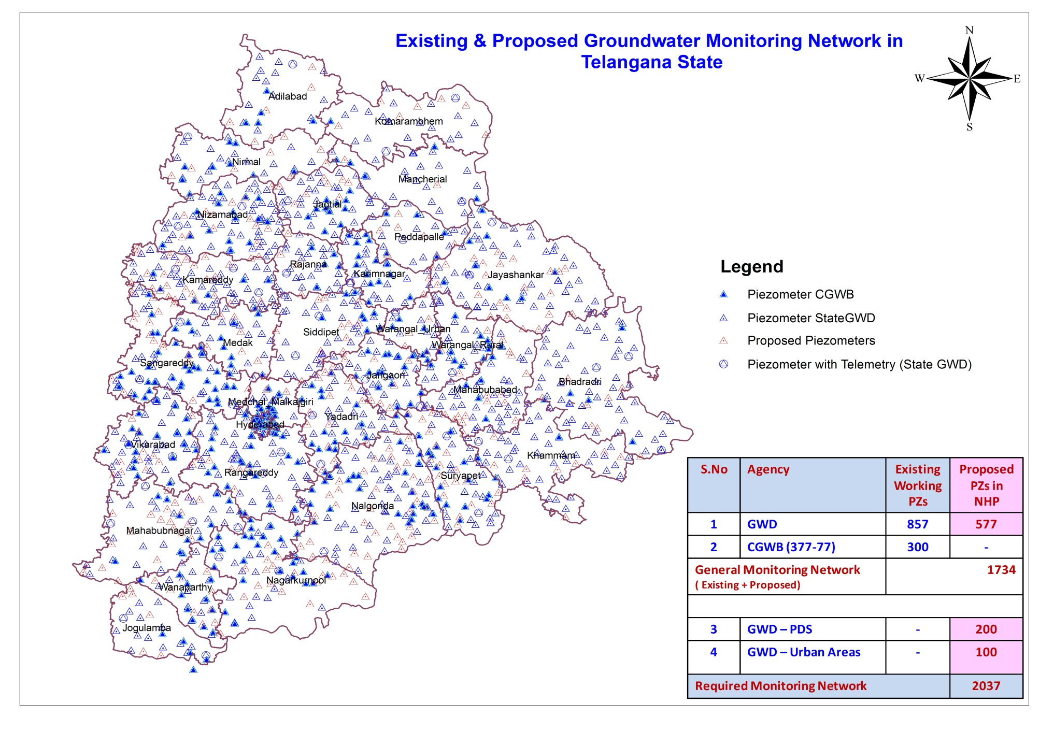
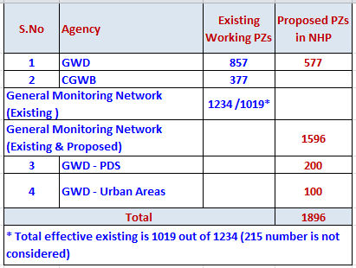
Contd…

Slide 16
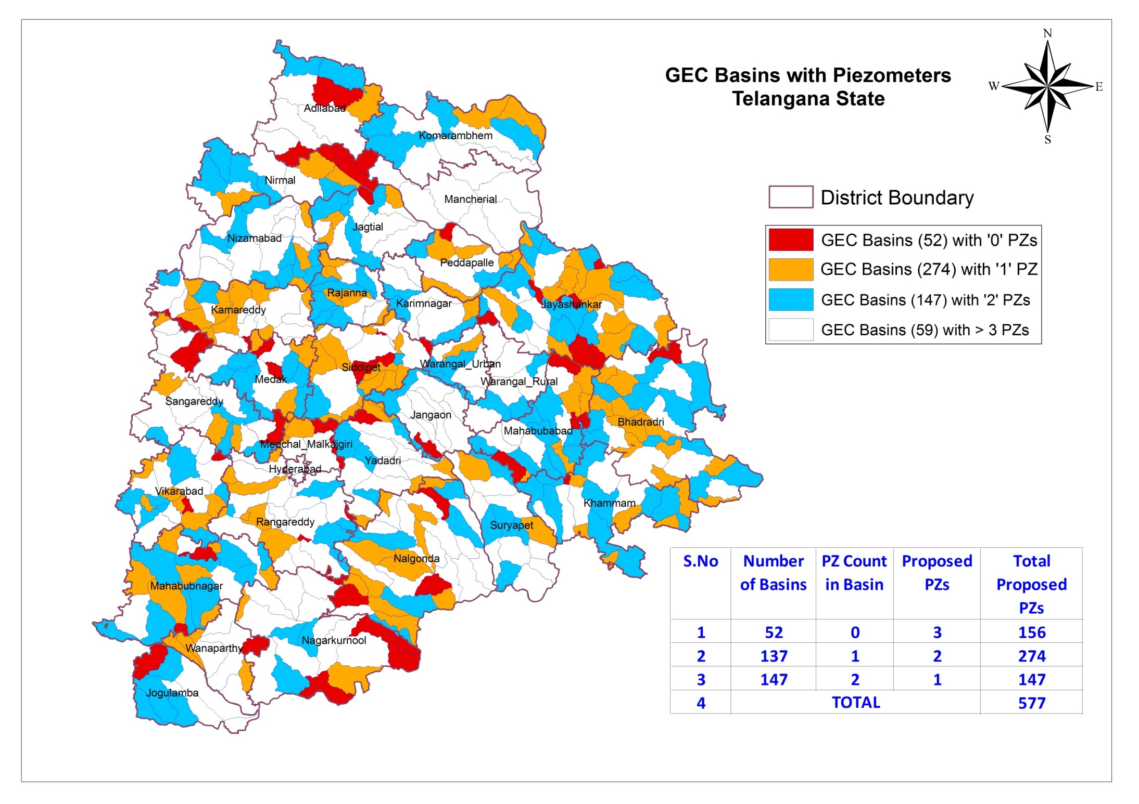

Slide 17
11: Status of State WRIS
Government of Telangana State is planning to develop State WRIS in coordination with CGG and NRSC.
Irrigation, Groundwater and other Line departments i.e Agriculture, planning etc. are updating their respective data into the system.
Ground Water Department has shared the GW historical data and requested to incorporate two tier system for data updation from field itself which will have facility of data entry and validation levels.

Slide 18
12 : Status of Public Finance Management System( PFMS)
Registration of IA into the system is completed under PFMS Portal
Filing of expenditure was initiated under E-A-T Module of PFMS portal
Steps are being taken up by IA to complete the process of expenditure filing and others aspects of EAT module by August-17.

Slide 19
13 : Any other Issues
World Bank Consultant has evaluated the e-procurement system adopted by the State Government. In the absence of e-procurement system do the IAs shall follow the normal tendering procedures as it was done during HP Phase-II
Do the IA consider the rejuvenation/maintenance of CGWB working piezometers since the monitoring network is integrated.

